Slide 1

INDIaN institute of engineering science and technology, shibpur
Group members (ID)
Kumar Suryamauli Shah-510617041 Electrical Engineering(2017-2021)
Nand Kumar Nitesh-510617042 3rd Semester (2nd Year)
Shreyan Banerjee – 510617043 10th DECEMBER, 2018.
Angshuman Ray – 510617045
Divyansh Srivastava -510617050
Ankit Verma – 510617051

Slide 2
Project Topic
Simple Inverter circuit using MJ2955
(PNP transistors)

Slide 3
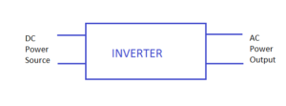
An inverter is connected to a DC source and it converts it into AC power in its circuit.
Introduction
Introduction to Inverters

Slide 4
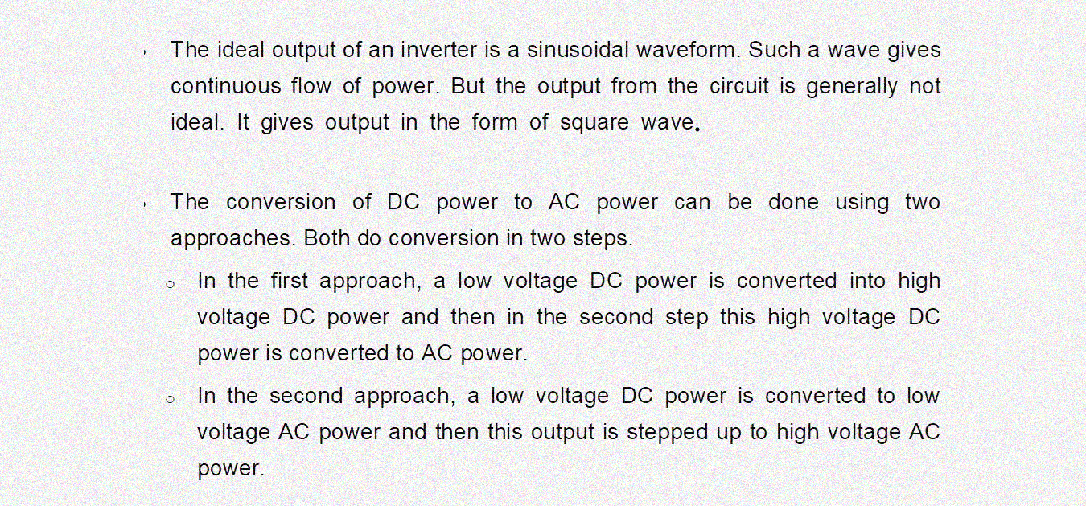
Working principle of inverter

Slide 5
Applications of inverters
•
They are used in AC motor drive
s with adjustable speed.
•
They are used in UPS (Uninterruptable Power Supply) which is a very
common application now a days.
•
They are
being used in portable devices.
•
They are used in power generation systems.
•
Inverters are used where there is a need to run AC devices from batteries.
•
They are also used in hybrid and electric cars.
•
They also find applications in motor speed controllers.
.

Slide 6
Simple inverter Circuit (9/12vdc to low Volt Ac to high volt 220v AC)

Slide 7
DESCRIPTION OF COMPONENTS
MJ2955 transistor
Emitter Cut-off Current
IBEO Max – 5mA
Base Emitter On Voltage
VBE Max-1.5 V

Slide 8
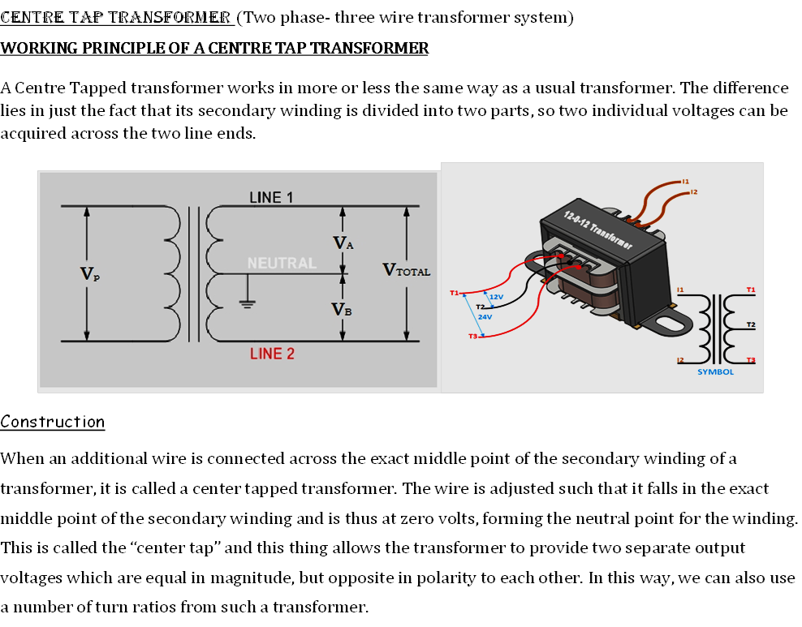

Slide 10
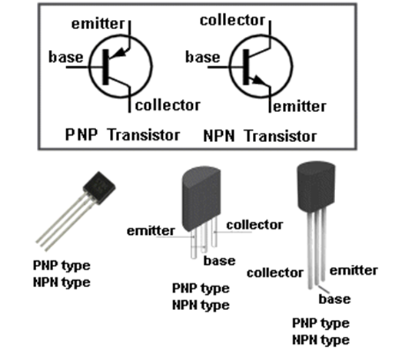
Testing of Components

Slide 13
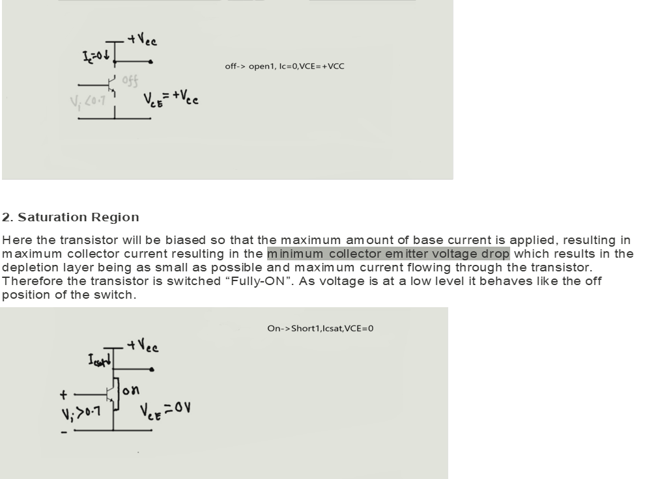

Slide 14
Astable
Multivibrators are free running oscillators which oscillate between two states
continually producing two square wave output waveforms.
It
uses switching operations between two transistors to generate two outputs from a single
I
nput
dc signal. The time of switching is controlled by
a capacitor chargin
g time consta
nt
.

Slide 15
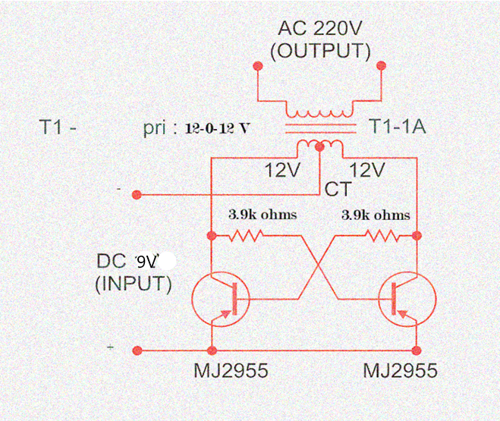
Circuit Diagram

Slide 16
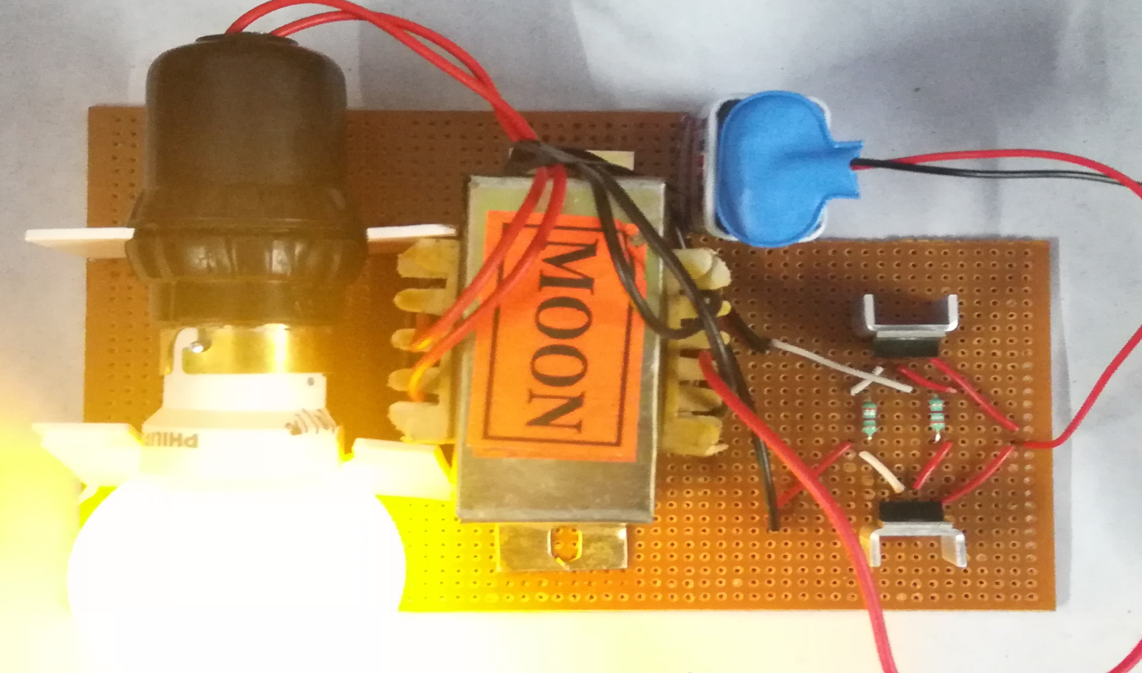
Model View

Slide 17
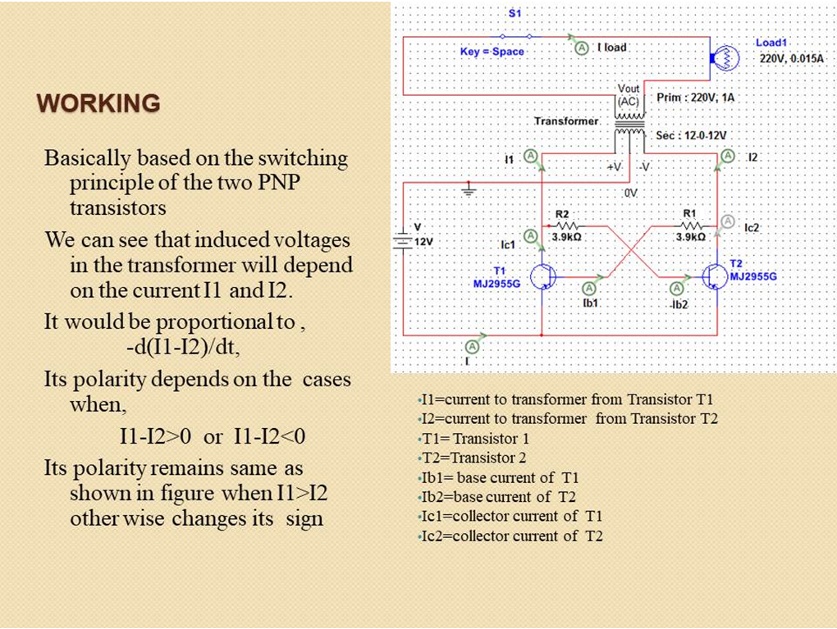

Slide 18
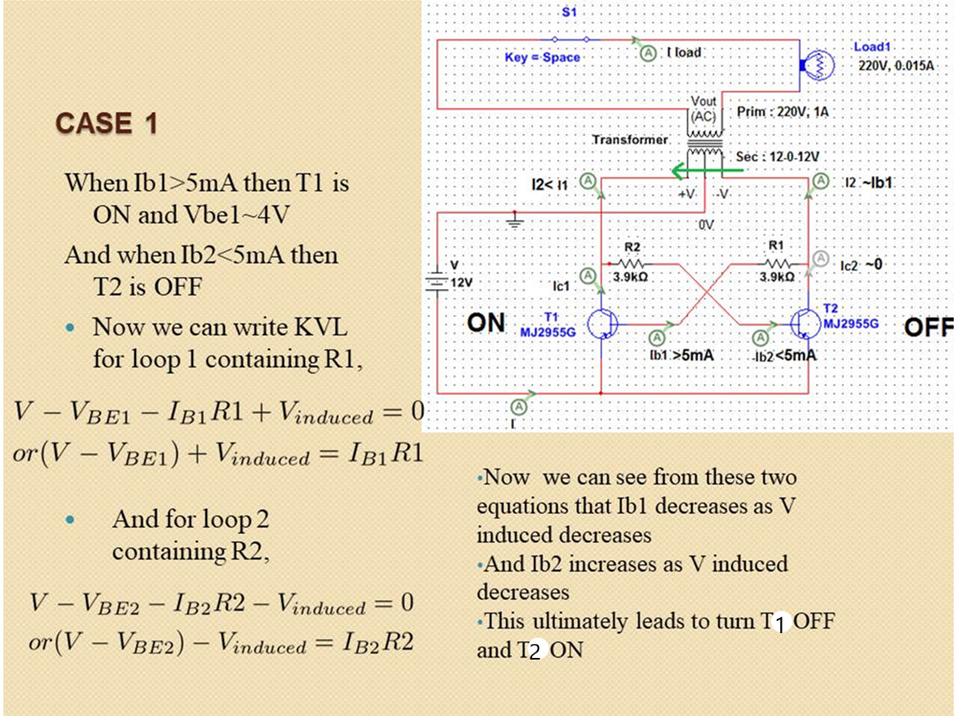

Slide 19
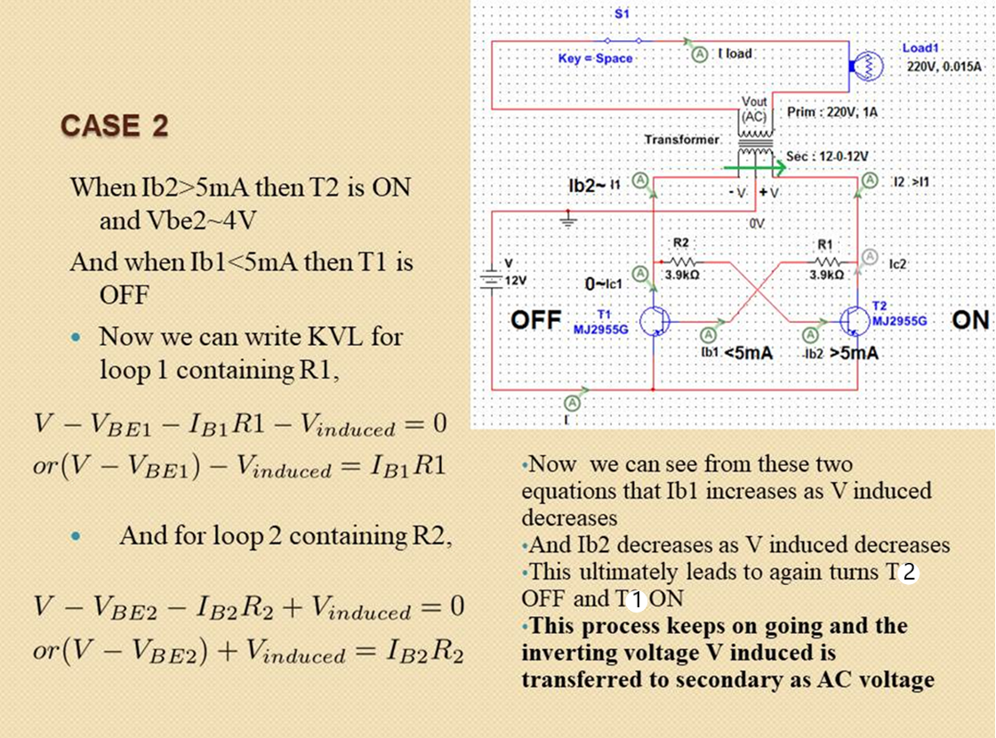

Slide 20
1) Voltage applied- 9V 2) Current through battery- 86mA 3) Power input- 0.774W 4) Induced emf across primary- 7.2V 5) Voltage at output end- 116V
Data Recorded in our analysis

Slide 21
Advantages and disadvantages
Advantages:-
1) It is cost effective and we can use this model in rural areas where want of electricity is a serious issue and we can use it in solar panels.
2) It is lighter and smaller in size, and hence can be easily transported.
3) It’s noise-free in functioning when compared to traditional generators.
4) Requires less maintenance. 5) The Inverter can power a few appliances for a short period.
6) DC power source utilization.
7) Uninterruptible power supplies.
8) Inverters can be very helpful during power cuts.
Disadvantages:-
It is useful only for small light bulbs or loads maximum upto 10 watt lamps.
There is huge amount of power loss in the circuit due to copper loss and
heat produced in the transistors.
3) Output waveform is not a pure sine wave.

Slide 22
………
Conclusion
After designing our simple dc to ac inverter, we have observed that the converter is converting around 9v dc to supply ac through proper circuit by using 9V to 150V center tapped transformer we are increasing the voltage and thus we can glow a light for a certain period.
Ac cannot be stored for future use whereas dc can be stored in battery & it can be converted back to ac by using power inverters when required.
Thus finally we have successfully completed our project & by observing its results we can say that it is very important power cut solution for this era & also a potential material for coming years……

Slide 23
Thank you

